Slide 1



Direct and Indirect Measures in Taskstream
Summer 2020 Workshop: Taskstream Series #6
presented by: Mary Elizabeth Spence
July 13, 2020
AState.edu
/ArkansasState
@ArkansasState

Slide 2



Workshop Procedures
Welcome and thank you for participating in our Summer Workshop Series!
You will be muted upon entry to the workshop, so please introduce yourself via the Chat feature by clicking “Chat.”
The window to the right will appear where you can add your introduction:
If you have questions during the session, please add them to the Chat box and at the conclusion of our time we will include them in the Q and A.
AState.edu
/ArkansasState
@ArkansasState

Slide 3
Workshop Agenda
Attendees will be able to:
How to report data accurately and clearly
  Summary of Findings that includes frequency/demographic information of students (number of students, level, etc.), date/semester of measure, item/rubric analysis, etc.
  Sampling Methodology if applicable
  Include all raw substantiating evidence
Peer Review Assessment Findings Rubric
AState.edu
/ArkansasState
@ArkansasState

Slide 4
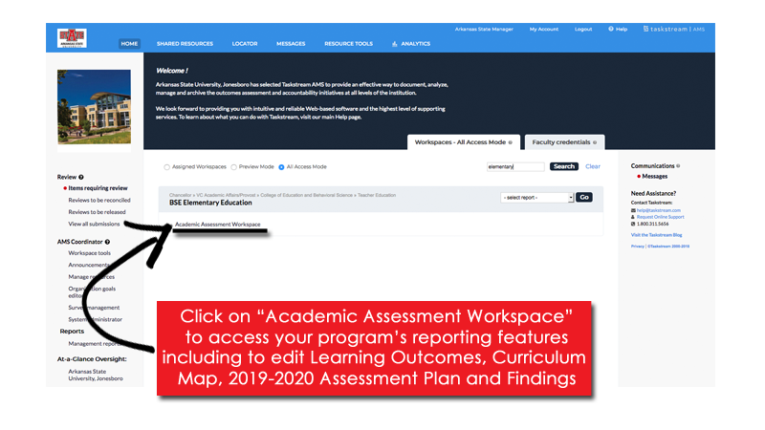

Taskstream Welcome Screen
This screen will show any Programs that you have access to view/edit.
AState.edu
/ArkansasState
@ArkansasState

Slide 5
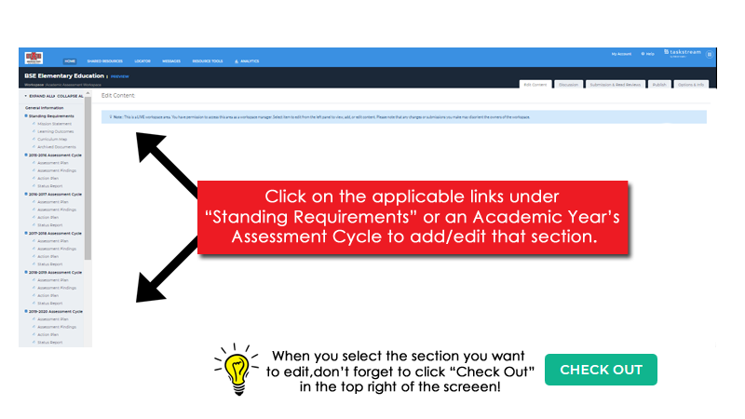
Workspace Landing Screen
This is the initial screen you will see when you select a Workspace.
AState.edu
/ArkansasState
@ArkansasState

Slide 6
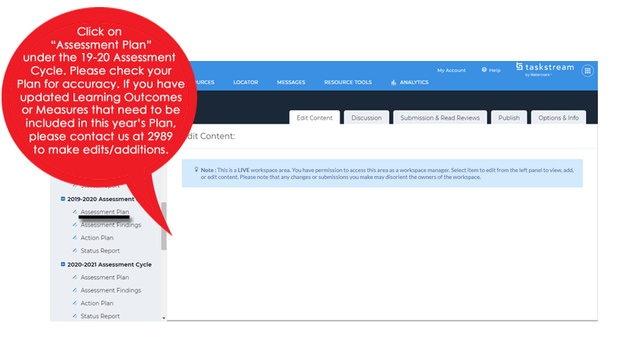
Assessment Plan
AState.edu
/ArkansasState
@ArkansasState

Slide 7
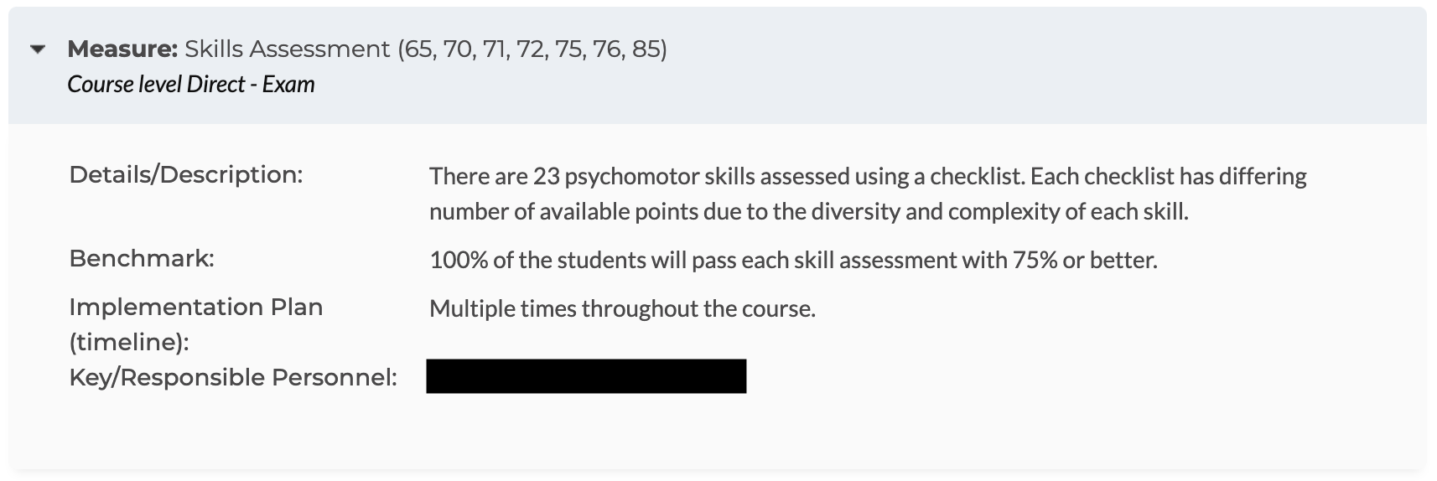
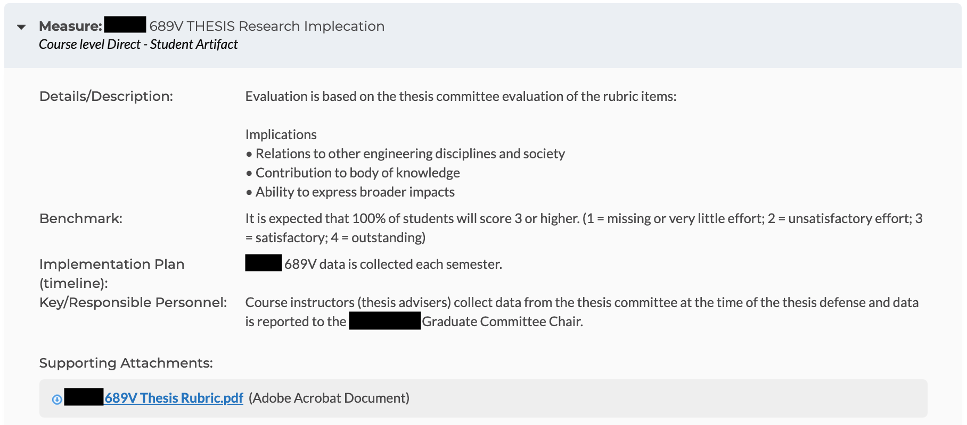
Direct Measure Examples
AState.edu
/ArkansasState
@ArkansasState

Slide 8
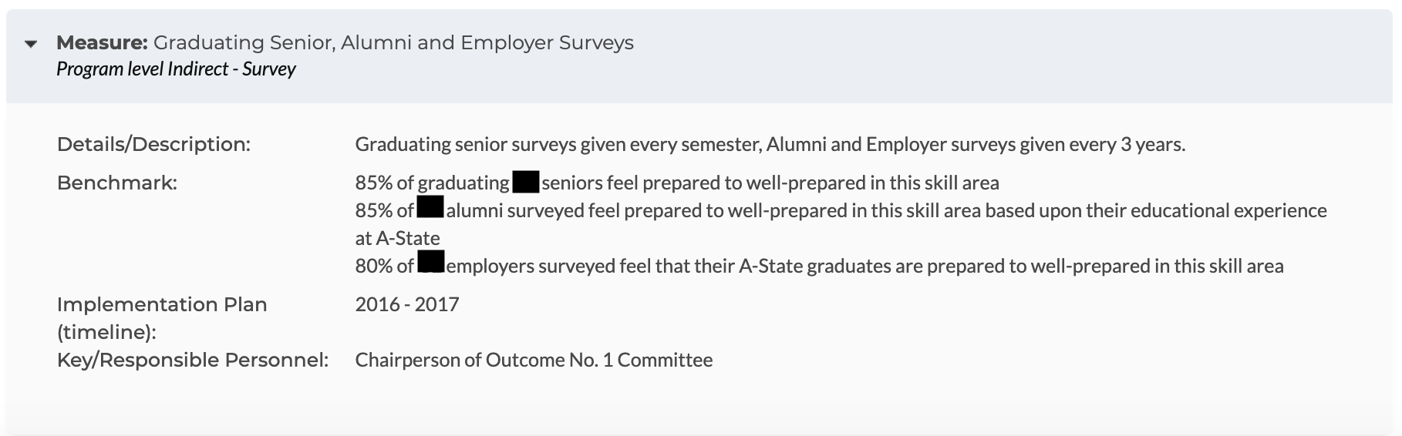
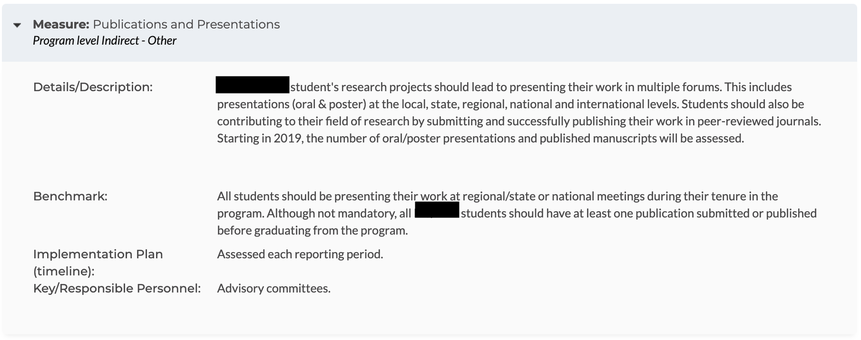
Indirect Measure Examples
AState.edu
/ArkansasState
@ArkansasState

Slide 9
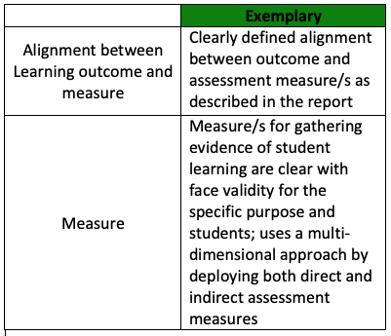
Assessment Plan Reporting Tips
Definition of Measure and Alignment between Measure and Outcome
-For best practice, include multiple measures (either multiple directs (exam, rubrics, etc.) or ideally at least one direct and one indirect (student survey, focus group, etc.)) that “speak” directly to the outcome(s) being measured with a clear alignment between verb(s) used and type of instrument “measuring” student success. i.e. “identify” is applicable when using a multiple choice exam, while “analyze” can be used with a rubric assessing a speech or paper.
-Please refer to the graphic below for “Exemplary” assessment plan reporting suggestions (For the Peer Review rubric in totality, please see attachment to this email.):
AState.edu
/ArkansasState
@ArkansasState

Slide 10
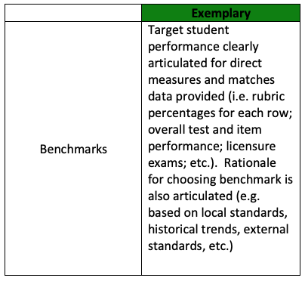
Assessment Plan Reporting Tips
Definition of Benchmark, Student Learning Success
-For best practice, include “Benchmarks” or student learning success definitions for each direct measure. For example, if using a multiple choice exam, this can be defined as “All students will score an 80% or better” and include the rationale for this definition of success. If using a rubric, an example is “All students will score a 3 of 4 or better on all rows of the rubric” and include the rationale for this definition of success.
-If the measure being used is a nationally-normed assessment, cut scores or percentage pass rates should be used as the Benchmark. For example “All students are expected to pass the exam on first attempt with a score of 235.”
-Please refer to the graphic below for “Exemplary” assessment plan reporting suggestions (For the Peer Review rubric in totality, please see attachment to this email.):
AState.edu
/ArkansasState
@ArkansasState

Slide 11

Session Q & A
AState.edu
/ArkansasState
@ArkansasState

Slide 12

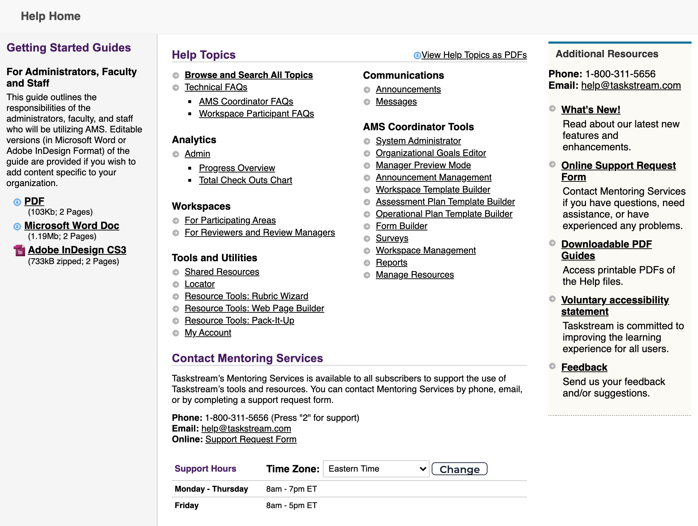
Taskstream Help
For “after hours” assistance, Taskstream has a number of great resources including contact by email and phone and a substantial set of guides. All can be accessed by clicking “? Help”:
AState.edu
/ArkansasState
@ArkansasState

